Slide 1
Committee Meeting
Cassidy Northway
PhD Candidate
Sept 19, 2024

Slide 2
Agenda
Review Project Outline
Current Progress and Modifications to Project
Surface Guided Radiation Therapy Project

Slide 3
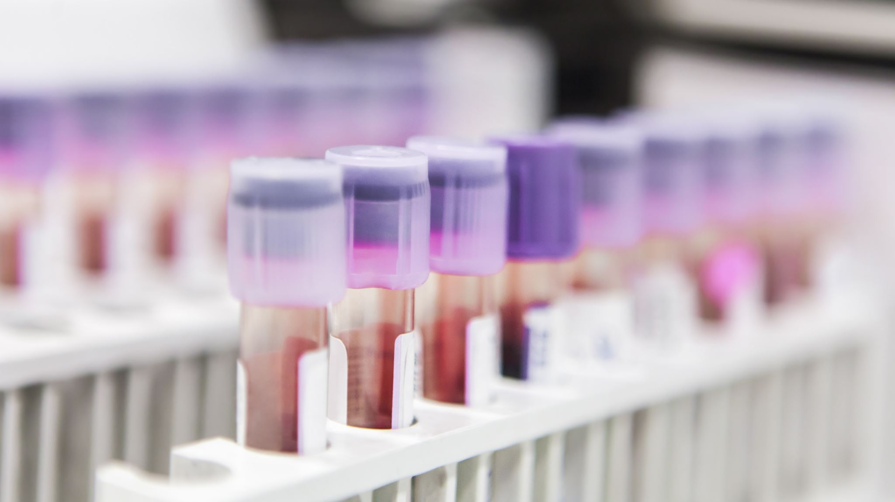
How heterogenous is the dose delivered to the circulating blood volume during TBI?

Slide 4
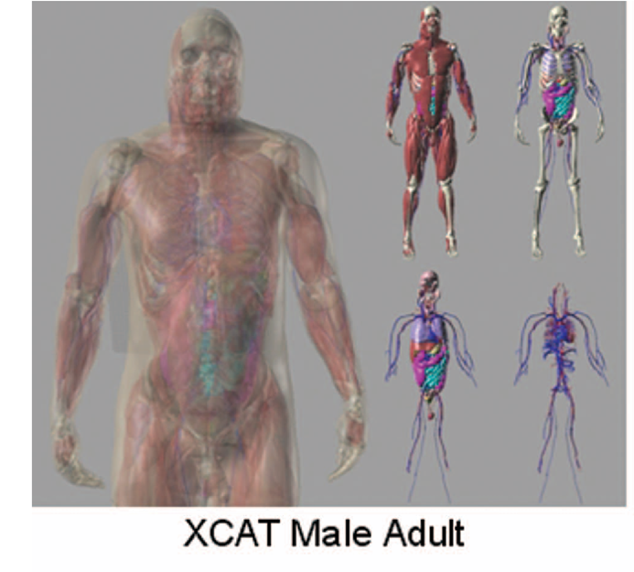
Initial Proposed Project
In-silico, track the flow of blood voxels through a whole-body phantom undergoing TBI, calculate their cumulative dose, and compare the dose to the voxels.
Whole Body Phantom (4D XCAT) model will unite a blood flow model and Monte Carlo Simulations to determine dose.
Notes:
Segars, William Paul, Jason Bond, John P. Frush, Sylvia Hon, Christopher P. Eckersley, Cameron H. Williams, Jianqiao Feng, Daniel Jacob Tward, J. Tilak Ratnanather, M. I. Miller, Donald P. Frush and Ehsan Samei. “Population of anatomically variable 4D XCAT adult phantoms for imaging research and optimization.” Medical physics 40 4 (2013): 043701 .

Slide 5

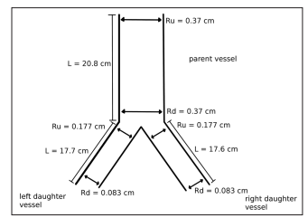
Progress to Date – Blood flow
Pulled the geometric information from the 4D XCAT phantom
Mapped the network
Created 1D-0D blood flow modelling code base
Used open-source VaMpy code base
Modified to use Structured Tree boundary conditions.
Confirmed methodology using a “toy example”
Notes:
Diem, Alexandra & Bressloff, Neil. “VaMpy: A Python Package to Solve 1D Blood Flow Problems.” Journal of Open Research Software. 5, 17, 2017.

Slide 6
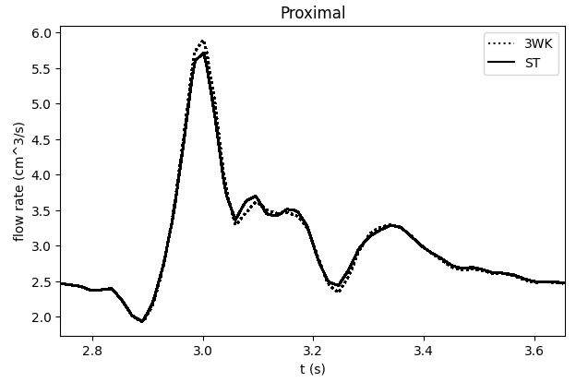
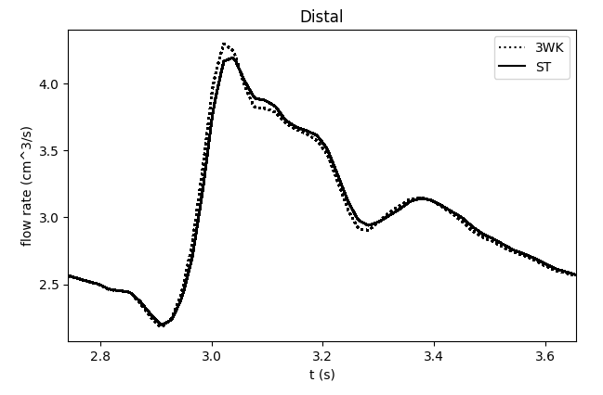
Max difference (absolute) = 0.2 cm^3/s
Notes:
Diem AK, Bressloff NW. VaMpy: A Python Package to Solve 1D Blood Flow Problems. Journal of Open Research Software. 2017;5(1). doi:10.5334/jors.159

Slide 7
“ One problem is however, that the rather complicated system of equations does not converge for all choices of parameters (the peripheral resistance, the top radius, and the bottom radius.” – Dr. Mette Olufsen
0.006% of one period after months of work.

Slide 8
Current Status – Blood Flow Modelling
Attempted to us established geometries for a limited number of systemic arteries [1]. Reached to 6%. Time to pivot again.
Notes:
[1] Cousins W, Gremaud PA. Impedance boundary conditions for general transient hemodynamics. International Journal for Numerical Methods in Biomedical Engineering. 2014;30(11):1294-1313. doi:10.1002/cnm.2658
[2] Alastruey, J., Parker, K. H., & Sherwin, S. J. (2012). Arterial pulse wave haemodynamics. In S. Anderson (Ed.), 11th International Conference on Pressure Surges (pp. 401-443). Virtual PiE Led t/a BHR Group.
[3]

Slide 9
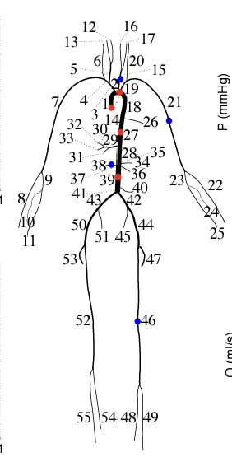
Current Status – Blood Flow Modelling
Attempted to us established geometries for a limited number of systemic arteries. [1] Reached to 6%. Time to pivot again.
Nektar 1D [2] is a Linux based, solves the nonlinear, one-dimensional (1-D) equations of blood flow in a network of compliant vessels subject to boundary and initial conditions.
We will use the existing 55-vessel model.
Notes:
[1] Cousins W, Gremaud PA. Impedance boundary conditions for general transient hemodynamics. International Journal for Numerical Methods in Biomedical Engineering. 2014;30(11):1294-1313. doi:10.1002/cnm.2658
[2] Alastruey, J., Parker, K. H., & Sherwin, S. J. (2012). Arterial pulse wave haemodynamics. In S. Anderson (Ed.), 11th International Conference on Pressure Surges (pp. 401-443). Virtual PiE Led t/a BHR Group.
[3]

Slide 10
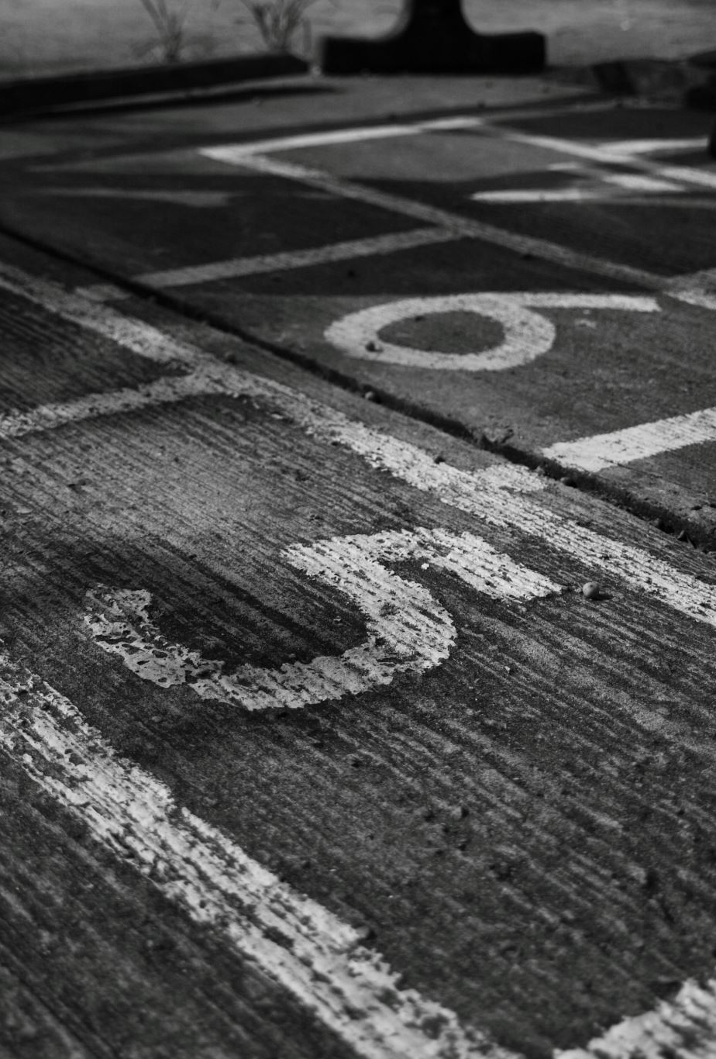
How do we address a one-way street?

Slide 11
Blood volumes will have the following properties within the simulation:
Location
Energy deposited (dose)
Time spent within the modelled arteries
Notes:
Source

Slide 12
Blood volumes will have the following properties within the simulation:
Location
Energy deposited (dose)
Time spent within the modelled arteries
At t < 0
Seed blood volumes, all starting at the aortic root
Random start times to prevent clustering
Notes:
Source

Slide 13
Blood volumes will have the following properties within the simulation:
Location
Energy deposited (dose)
Time spent within the modelled arteries
At t < 0
Seed blood volumes, all starting at the aortic root
Random start times to prevent clustering
t >= 0 sec
Track the volumes through the known arteries and the energy deposition
Assume 60 secs from aortic root to aortic root, “Round trip”. ~5 L blood volume and ~ 4-8 L/min cardiac output. TBD
Notes:
Source

Slide 14
Blood volumes will have the following properties within the simulation:
Location
Energy deposited (dose)
Time spent within the modelled arteries
At t < 0
Seed blood volumes, all starting at the aortic root
Random start times to prevent clustering
t >= 0 sec
Track the volumes through the known arteries and the energy deposition
Assume 60 secs from aortic root to aortic root, “Round trip”. ~5 L blood volume and ~ 4-8 L/min cardiac output. TBD
Dose deposited/total time of exposure will be compared
Notes:
Source

Slide 15

Questions?

Slide 16
Beam modelling
Will be modelling:
Co-60
POP
VMAT
With my work with Dr. Popescu preparing data for a CARO 2024 poster I’ve looking at modelling our sweeping Co-60.
Co-60 modelling is currently being updated from Levi Burns’ work [1].

Slide 17
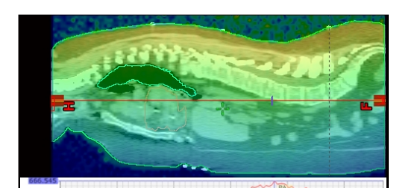
Beam Modelling: additional inquiries
Does the cropping of patient CTs (chin to pelvis) affect the dose calculations significantly?
“Another crucial parameter for accurate dose verification at treatment center was found to be the amount of material available between the central axis and the phantom edge for scatter (in the caudal direction). Variation up to 7% have been observed.” [1]
Using the 4D XCAT phantom we can calculate cropped and uncropped dose to compare.
Notes:
[1] Teke T. Monte Carlo Techniques for Patient Specific Verification of Complex Radiation Therapy Treatments Including TBI, VMAT and SBRT Lung. University of British Columbia; 2012. doi:10.14288/1.0072786

Slide 18
Beam Modelling: additional inquiries
Not yet modelled Co-60 dose rates via MC.
We know dose rates are linked to pulmonary toxicities [1].
Using the methodology developed by Su et al. [2] we can obtain the absorbed dose to voxel per time interval.
Notes:
Total Body Irradiation: Guidelines from the International Lymphoma Radiation Oncology Group (ILROG) , Wong, Jeffrey Y.C. et al. International Journal of Radiation Oncology, Biology, Physics, Volume 101, Issue 3, 521 – 529
Su S, Atwal P, Lobo J, Duzenli C, Popescu IA. A new DOSXYZnrc method for Monte Carlo simulations of 4D dose distributions. Phys Med Biol. 2021 Dec 10;66(24). doi: 10.1088/1361-6560/ac3a24. PMID: 34787104.

Slide 19
Questions?

Slide 20
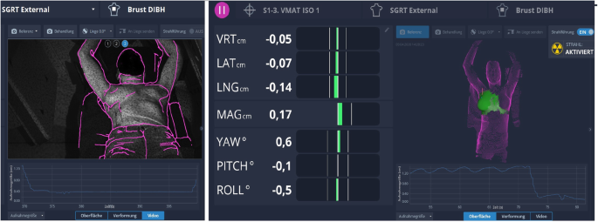
New Project – TBI Treatment Margins
BC Cancer – Vancouver has transitioned to VMAT TBI.
Surface guidance is used to aid in patient alignment.
This also provides with additional information on set-up error and patient motion during treatment at all isocenters.
Notes:
Freislederer, P., Kügele, M., Öllers, M. et al. Recent advances in Surface Guided Radiation Therapy. Radiat Oncol 15, 187 (2020). https://doi.org/10.1186/s13014-020-01629-w

Slide 21
Margins in TBI
Solid Tumour Treatment Planning
Total Body Irradiation Treatment Planning
CTV = Body Contour
PTV
CTV = Body Contour - Lungs
CTV
TBI: The PTV extends outside of the patient’s body, and we create a “flash” margin for Inverse Treatment Planning. Currently the margin is based on planner experience. After treatment planning the flash margin is removed and the dose is recalculated.
Flash margin: margin outside of the patient we fill with unit density material

Slide 22
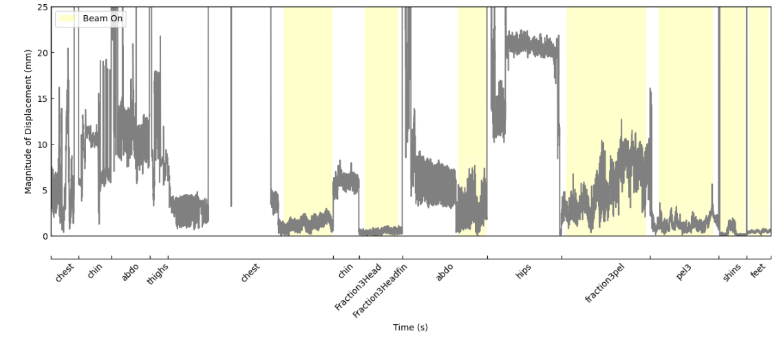

TBI Treatment Margins: Data informed
Using the SGRT we can calculate minimum treatment margins at each isocentre for VMAT TBI based on the work of van Herk et al. [1].
$2.5Σ+0.7σ$
$Σ$ – Std of systemic errors (Set-up error)
$σ$ – Std of random errors (Patient motion)
Goal: provide data-driven treatment margins
Notes:
[1] van Herk M, Remeijer P, Rasch C, Lebesque JV. The probability of correct target dosage: dose-population histograms for deriving treatment margins in radiotherapy. International Journal of Radiation Oncology*Biology*Physics. 2000;47(4):1121-1135. doi:10.1016/S0360-3016(00)00518-6

Slide 23
TBI Treatment Margins: TPS informed
Robustness study: QA tool built into our TPS which rigidly shifts the patient with the treatment field.
Determine the shifts that our current margin can tolerate.
Ideally: replan a subset of patients with our calculated “flash” margin and examine the changes to dose metrics as well as shift tolerance.

Slide 24
Questions?

Slide 25
Advanced to Candidacy
TA Professional Development Committee (2022-2024)
Northway, C., & Spadinger, I. (2023). A full body blood flow model for applications in TBI dosimetry. Radiotherapy and Oncology, 186.
Lymphoma Canada Grant (2023 – 2025)
Zhang, C., Northway, C., Crook, J., Hilts, M., & Batchelar, D. (2024). Seed distribution stability in permanent breast seed implant brachytherapy. Brachytherapy, 23(4), 433–442.
Jin, R., Oh, J., …, Northway, C., et al. The Incidence and Factors associated with Pulmonary Toxicity in Adults After Total Body Irradiation-Based Conditioning Regimens & Bone Marrow Transplantation.

